Slide 1
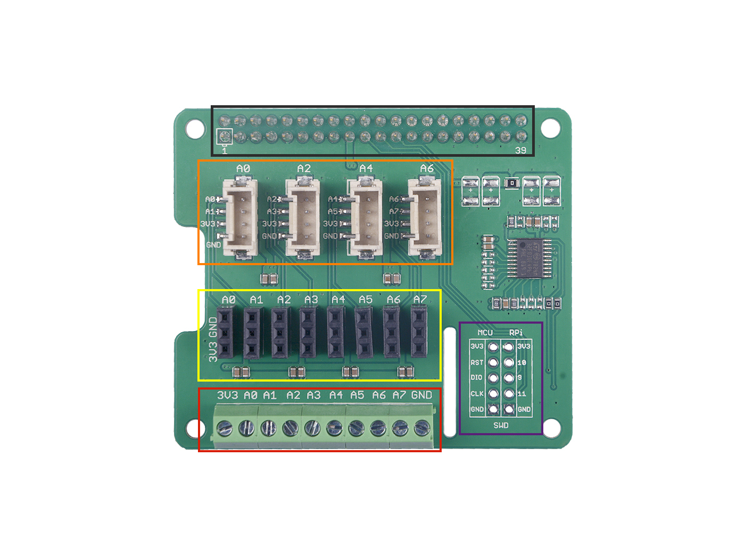
GPIO
Grove Port
(A0/A2/A4/A6)
Female Header
(A0~A7)
SWD
Screw Terminal

